Slide 1

Chranz AG
Innovation idea submission at
digitalization of the process
Authors:
Anja Lambinus
Mengyang Li
Valeriia Afonina

Slide 2
Agenda
Introduction
AS-IS Process of Innovation Request
TO-BE Digitalized Process
Improvements
Outlook

Slide 3

Introduction
Service Provider for regional banks
Legal
IT management
Controlling
risk management and marketing
Push innovation
Builded a platform Chranz AG
take over the orchestration
Basis for exchange within regional banks
Target: the bank can concentrate in doing banking

Slide 4
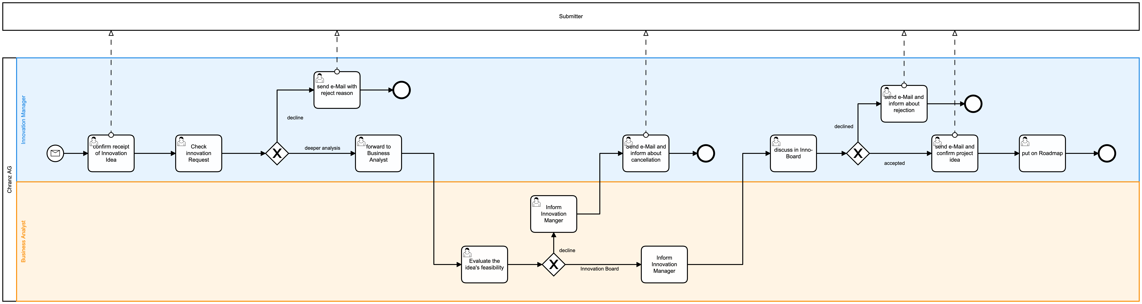
AS-IS process

Slide 5
AS-IS process

Slide 6

Issues
Quality of request
Unstructured request by mail
Must-information are not covered
Innovation ideas are listed on a PowerPoint
High error rate due to manual work
Only update-information by cancellation
No overview about open requests
No clear rule for decision
Subjective decision on feeling
Not transparent
Unclear where the request is

Slide 7
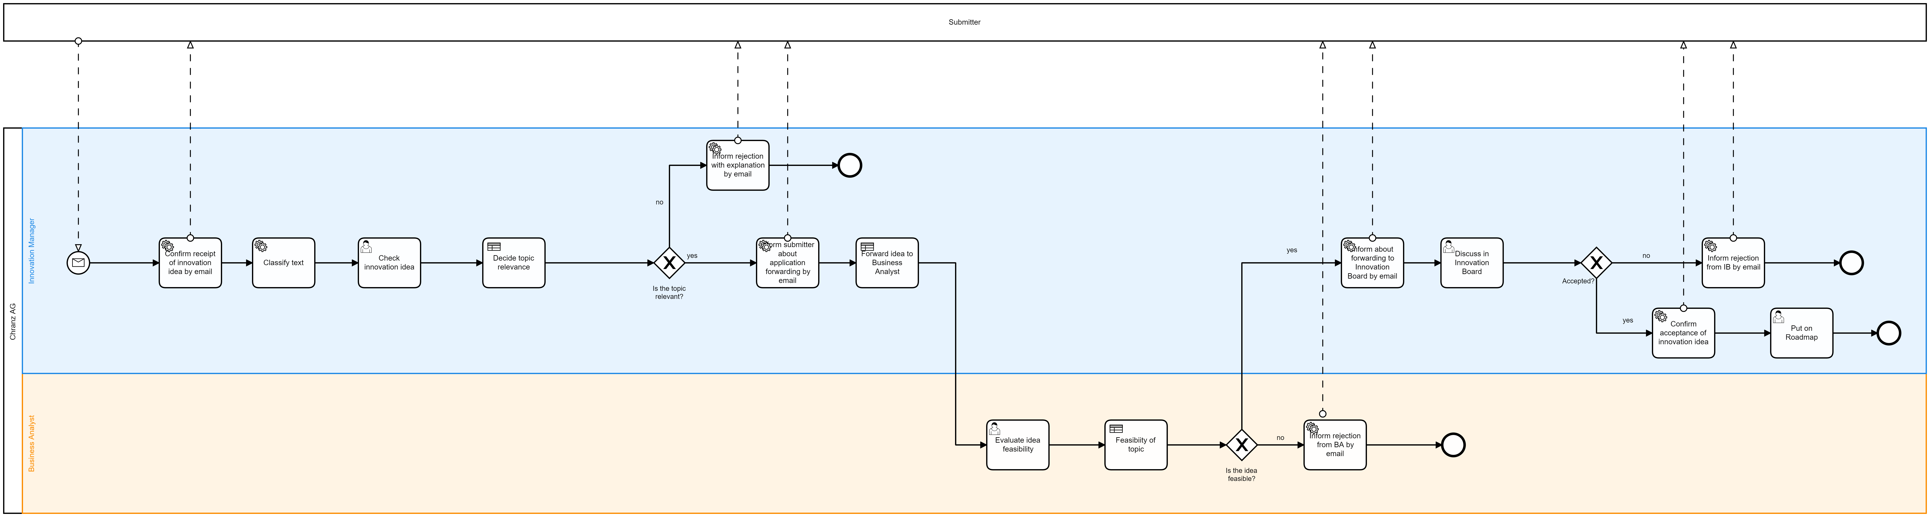
TO-BE Digitalized process

Slide 8



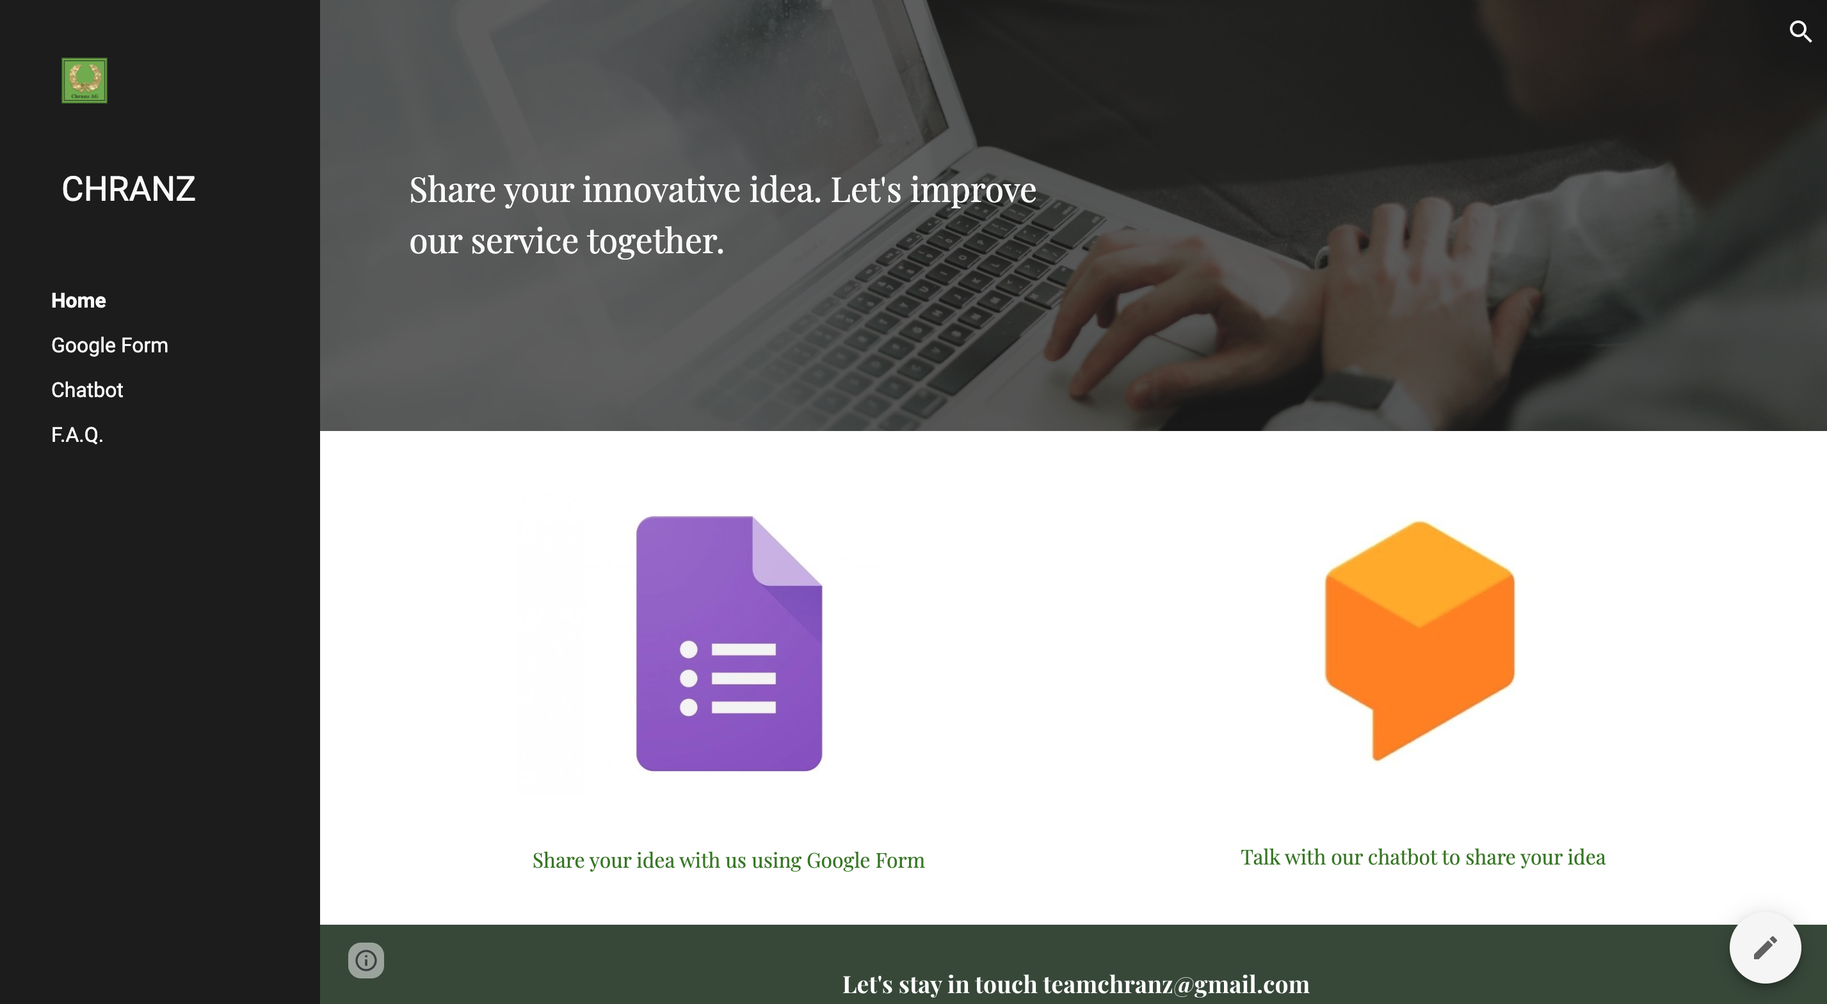
Web page with adaptive designto start the process

Slide 9
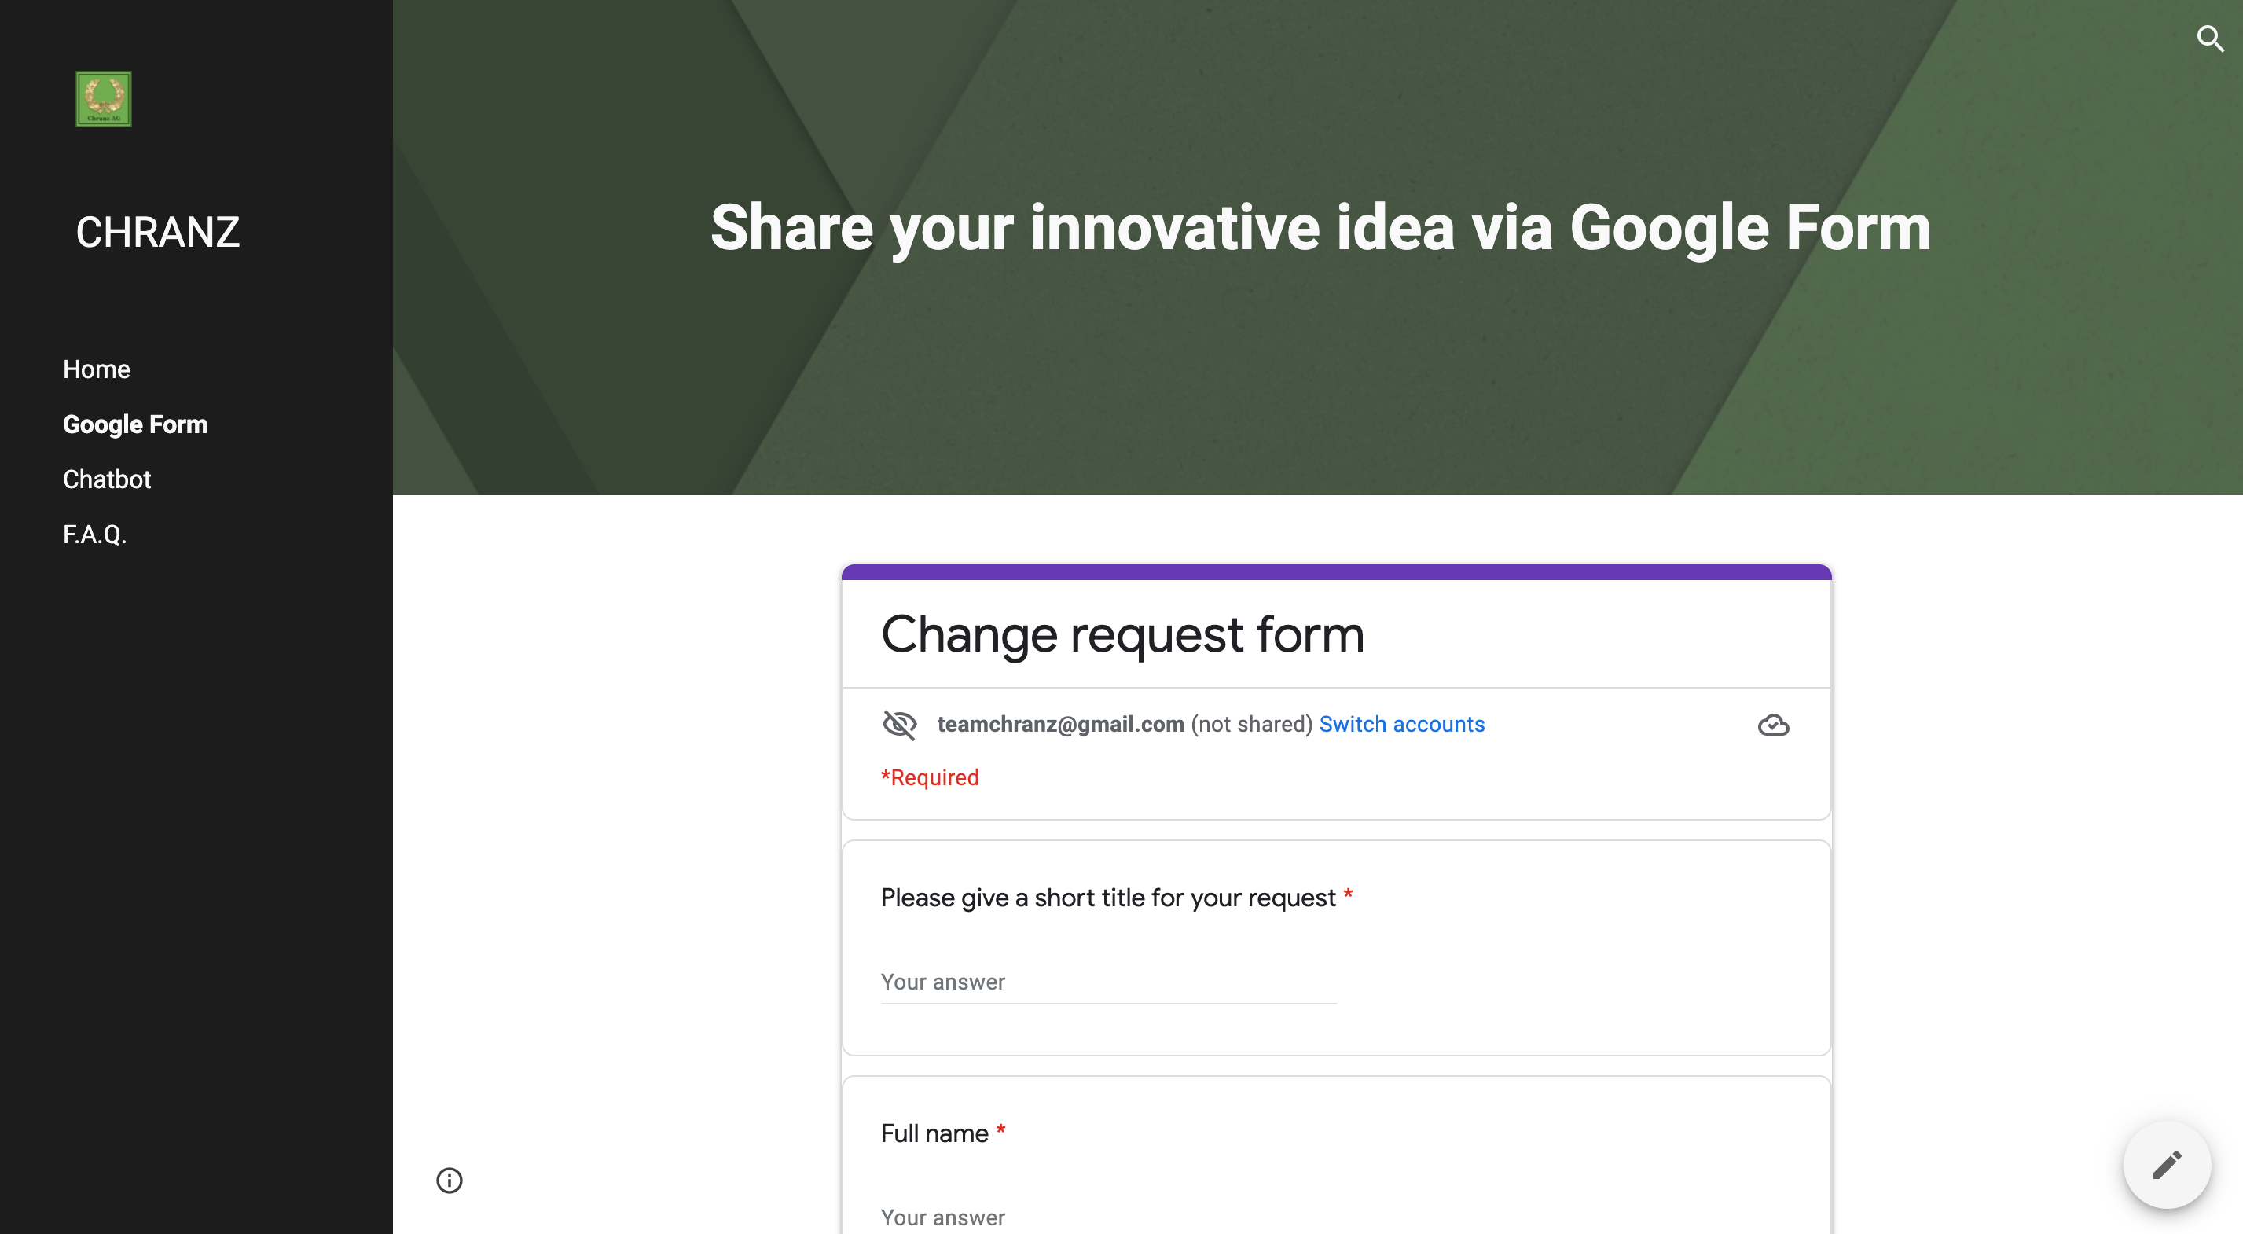
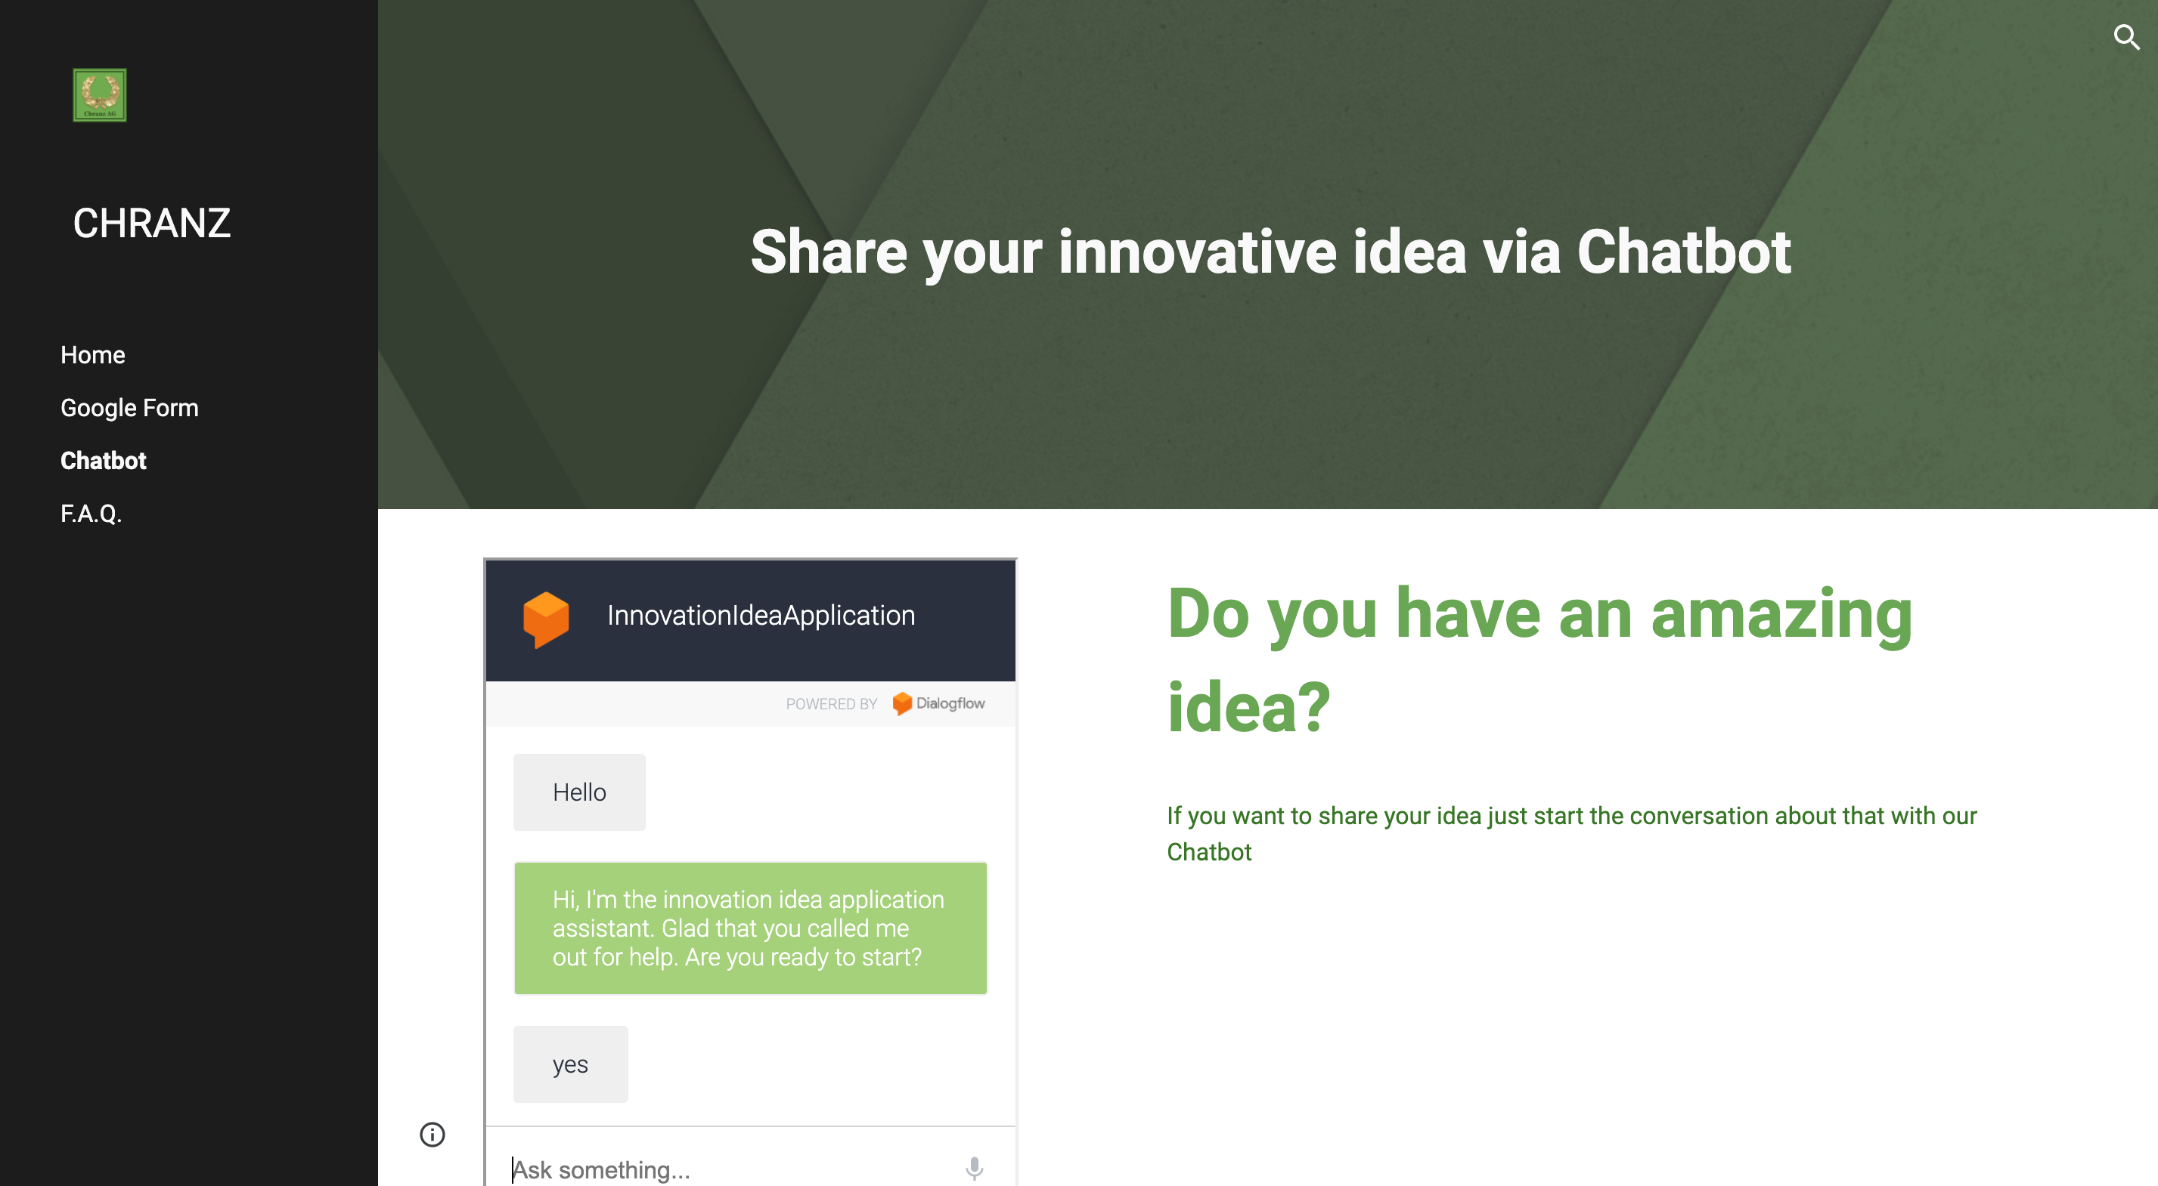
Two options for starting the process

Slide 10
TO-BE digitalized process

Slide 11
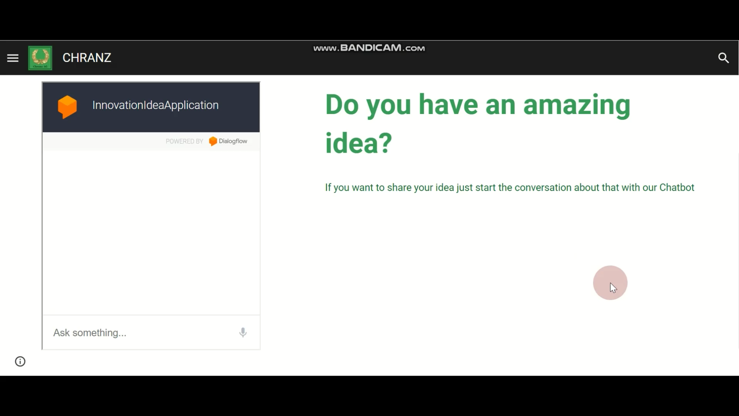
TO-BE Digitalized process. Chatbot

Slide 12

Improvements
Implemented a workflow internal
Implementation of a Website inclusive FAQ
Structured submission with Google form or chatbot
Automated status update to the submitter after each change
Improve transparency – decisions has clear rules
Reduce working time

Slide 13

Outlook
Proof of Concept was successful
Automate additional process - e.g. Roadmap planning
Connection to other process – e.g. Change Request, Roadmap
Reduce process time

Slide 14

Thank you for your attention!

